Slide 1
Case study (Bellabeat) : How Can a Wellness Technology Company Play It Smart?
Understanding Activity, Sleep, and User Engagement Patterns

Slide 2
Problem Statement : Unlocking Growth Opportunities for Bellabeat: Leveraging Data Insights to Drive Strategic Decision-Making
Background: Bellabeat, founded in 2013 by Urška Sršen and Sando Mur, is a leading manufacturer of health-focused smart products for women, offering activity, sleep, stress, and reproductive health tracking devices. With a global presence and a commitment to digital marketing, Bellabeat empowers women with personalized solutions, driving growth in the wellness industry.
Problem: Bellabeat needs to leverage data insights to drive strategic decision-making and address key business challenges. We want to answer the following questions:
How can we understand customer behavior and preferences to tailor products for women effectively?
What strategies can be implemented to optimize our product offerings based on sales data and market trends?
How can we enhance our marketing strategies by analyzing customer engagement and campaign effectiveness?
What opportunities exist for driving business growth through innovation and market expansion using data-driven approaches?

Slide 3
Analysis of Bellabeat products
Our analysis focuses on exploring and deriving insights from data collected from Bellabeat's health-focused smart products for women. We aim to understand various aspects such as activity levels, sleep patterns, calorie expenditure, and user engagement. Key areas of analysis include:
Activity Analysis: Examining daily activity levels, including total steps taken and active minutes, to understand users' physical activity patterns.
Sleep Analysis: Investigating sleep metrics such as total hours asleep, total time in bed, and sleep quality to gain insights into users' sleep patterns and habits.
Calorie Burn Analysis: Analyzing the relationship between total steps taken and calories burned to understand the effectiveness of physical activity in calorie expenditure.
User Engagement Analysis: Assessing user engagement by examining patterns in very active minutes and active versus non-active users to understand the level of interaction with Bellabeat's products.
Temporal Analysis: Exploring variations in activity, sleep, and calorie burn across different time periods, including hourly and weekly trends, to identify patterns and potential opportunities for intervention or improvement.

Slide 4
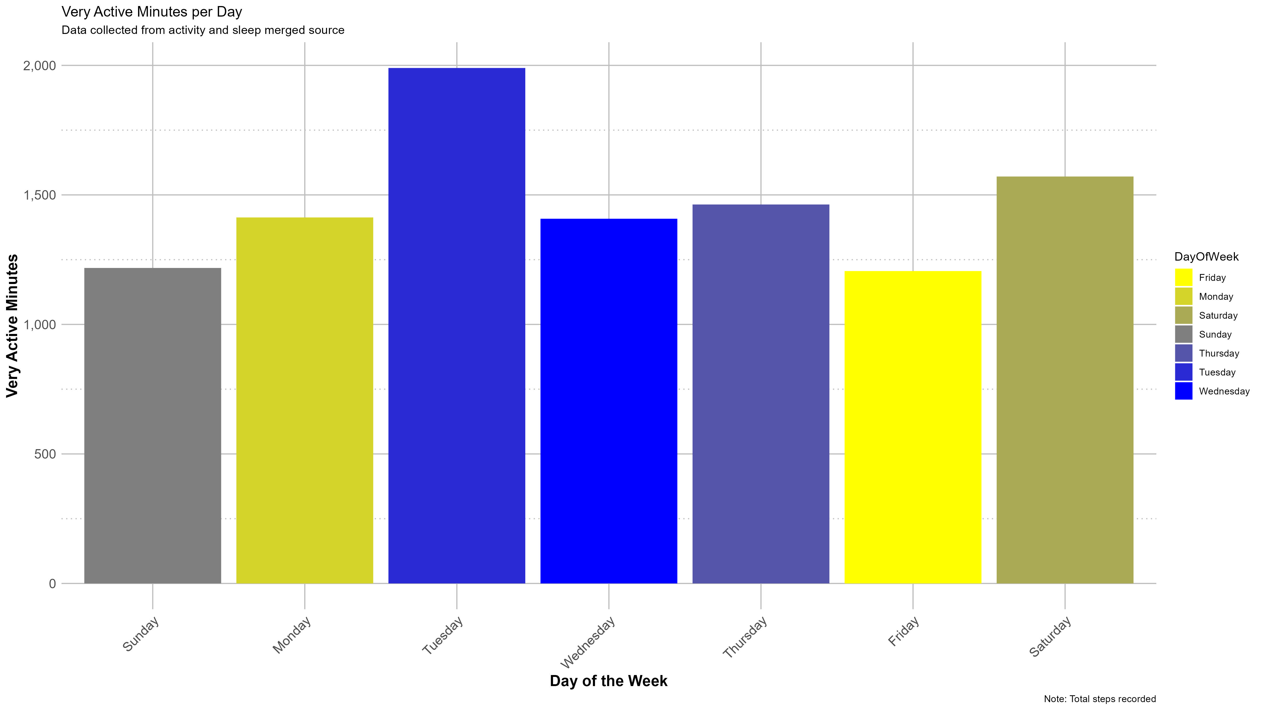
Activity Analysis Bar graph showing the distribution of very active minutes per day
Key Points:
Users are most active on Tuesdays.
Users are least active on Sundays.

Slide 5
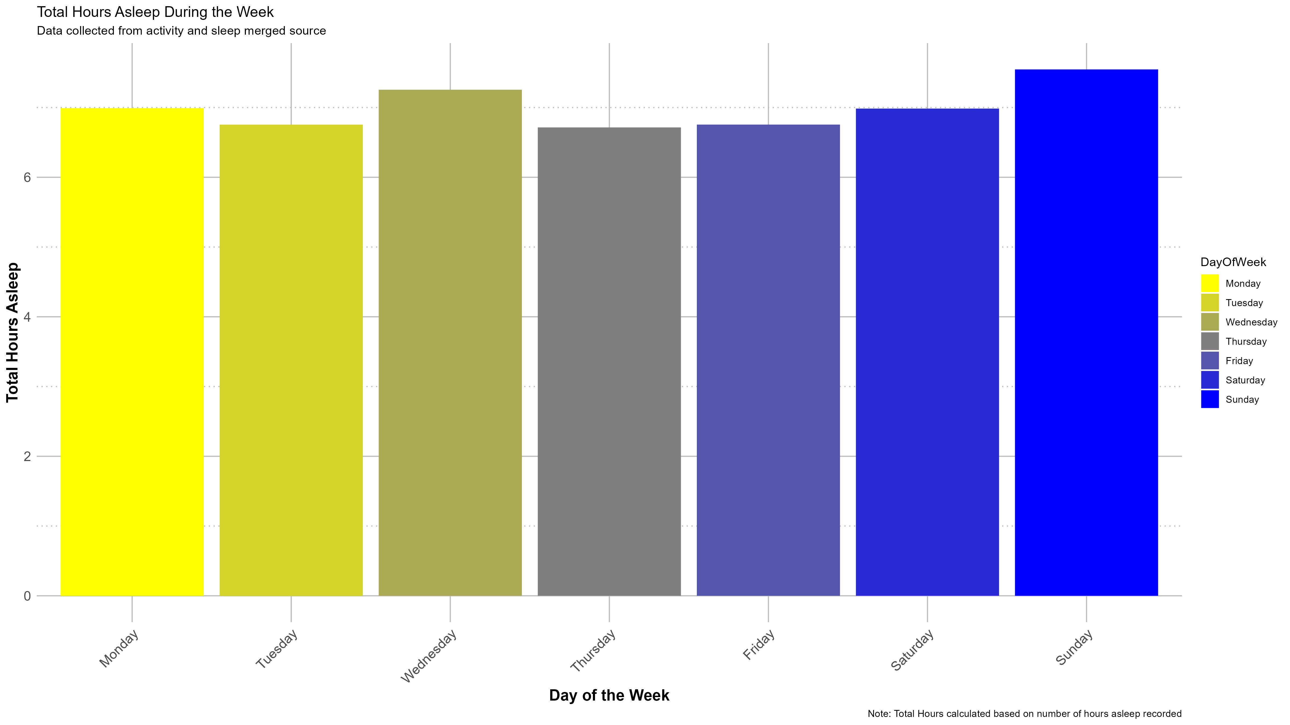
Sleep Analysis Bar graph showing the average hours asleep per day of the week
Key Points:
Users sleep the most on Sundays.
Users sleep the least on Thursdays.

Slide 6
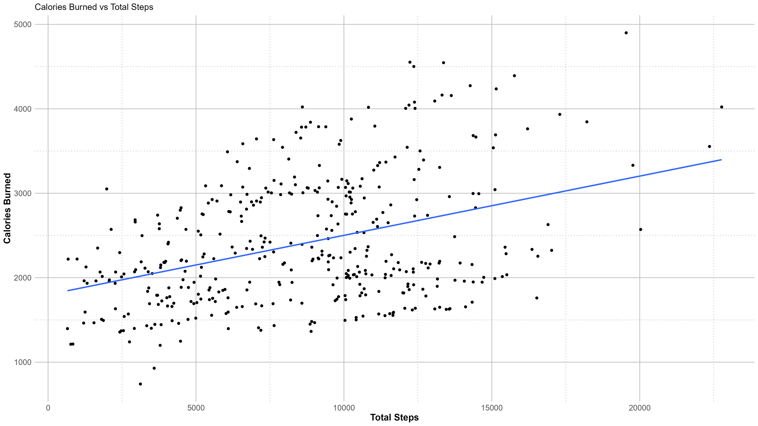
Calorie Burn Analysis Scatter plot depicting the relationship between total steps and calories burned
Key Points:
There's a positive correlation between total steps taken and calories burned.
Even with a high step count, the amount of sedentary time can significantly impact the total calories burned.

Slide 7
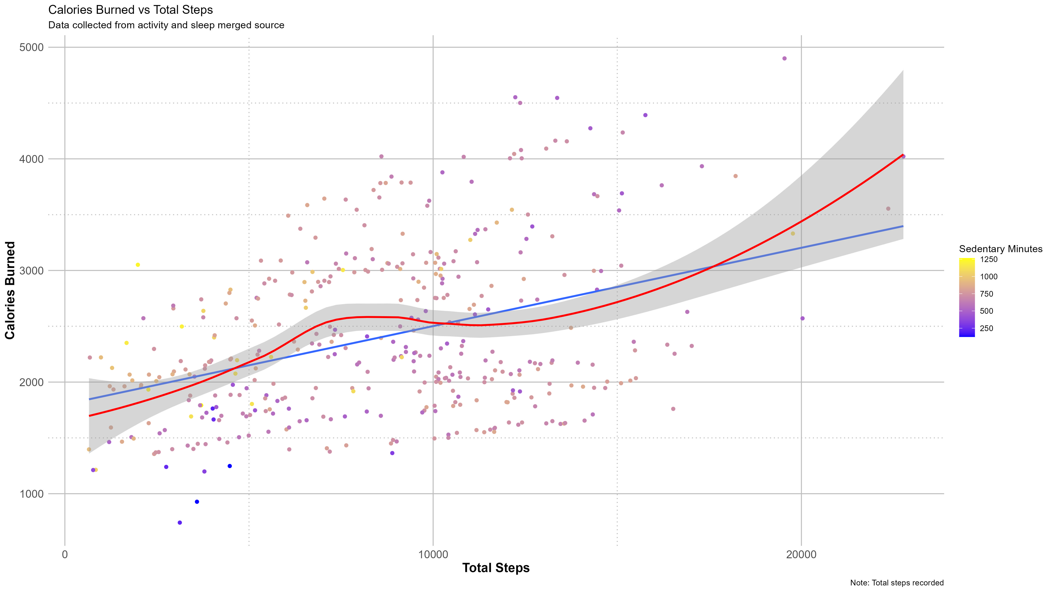
Sedentary Behavior Analysis Scatter plot showing the relationship between total steps and sedentary minutes
Key Points:
Users with a high step count can still have significant sedentary time.
Diverse lifestyle habits are observed among users.

Slide 8
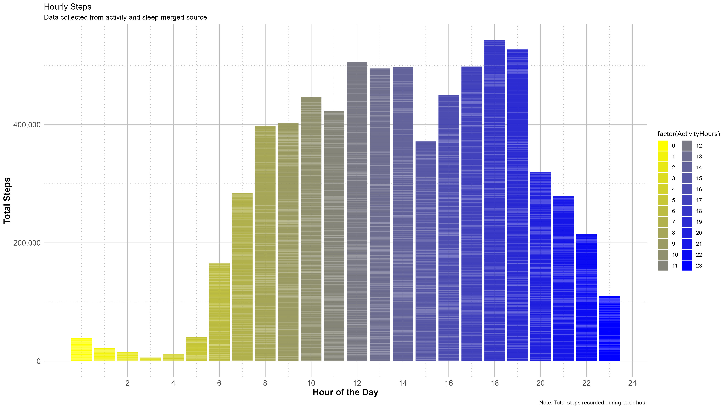
Temporal Analysis Bar plot showing hourly trends in steps taken
Key Points:
Users are more active during specific times of the day.
Clear pattern of activity is observed throughout the day.

Slide 9
Conclusion Summary: Summarize the key findings and insights from the analysis
Key insights:
1. Physical Activity and Caloric Expenditure: There is a positive correlation between very active minutes and calories burned, as well as between total steps and calories burned. This suggests that increasing physical activity levels can lead to higher energy expenditure, which is crucial for fitness and weight management.
2. Sleep Duration and Sedentary Behavior: Users who sleep more tend to be less sedentary, indicating a potential relationship between sleep quality and activity levels. Additionally, there is a progressive increase in sleep duration from Monday to Sunday, highlighting the importance of weekend recovery.
3. Activity Patterns and Lifestyle Habits: Weekly activity patterns vary significantly, with peaks observed on certain days such as Tuesday. This variation could be influenced by users' lifestyle habits, work schedules, or personal routines.
4. Sedentary Behavior Impact: Sedentary time significantly affects total calories burned, emphasizing the need to reduce sedentary behavior even when achieving high step counts. Addressing sedentary behavior could be essential for overall health and energy expenditure.

Slide 10
Recommendations
Personalized Goal Setting: Develop features to offer personalized activity goals tailored to users' weekly routines, encouraging consistent physical activity throughout the week.
Sleep Improvement Tools: Provide users with tools and resources to improve sleep quality, such as sleep tracking features and relaxation techniques, particularly focusing on weekdays to address any sleep deficits.
Sedentary Behavior Intervention: Implement features to prompt users to reduce sedentary behavior, such as reminders to stand up or move after prolonged periods of inactivity, promoting a more active lifestyle.
Educational Outreach: Create educational content within the app to raise awareness about the importance of physical activity, sleep hygiene, and reducing sedentary behavior. Empowering users with knowledge can motivate behavior change and improve overall health outcomes.

